Slide 1

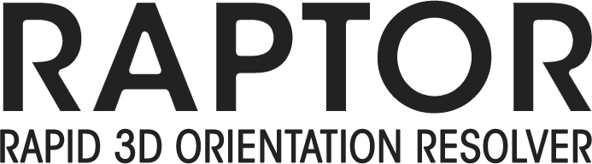

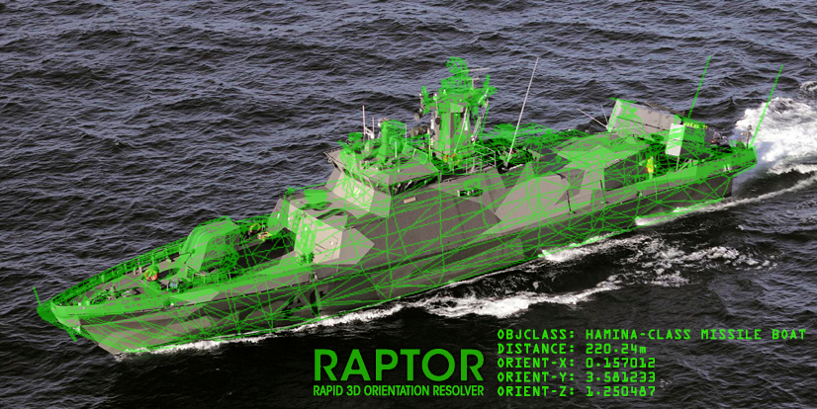


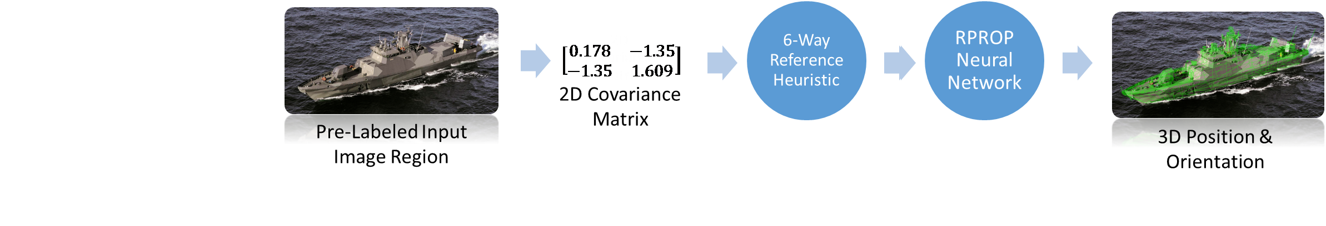
NREIP Student:
Sam Kelly
Dickinson College ’14 (B.S.)
Brown University ‘17 (M.A.)
kellys@dickinson.edu
Mentor:
David Aha
NRL Adaptive Systems Section
david.aha@nrl.navy.mil
Project Dates: Jun 27, 2014 – Aug 1, 2014
Project Objective and Research Approach:
Our goal with RAPTOR is to design a novel pipeline for inferring solely from 2D image data the 3D distance-from-camera and orientation (pose) of known classes of rigid objects for which man-made 3D models are available. We have devised and implemented three preliminary versions of the RAPTOR pipeline. Variant A generates 2D covariance matrices from input images, using class-specific neural networks to try to learn the mapping of 2D covariance matrix to 3D pose parameters directly (possibly in tandem with stereo vision). Variant B instead uses the rotational distance between the 2D covariance matrix for the input image and several reference poses as a feature vector. Variant C leverages a 3D model of the target object class to iteratively render poses, eventually converging on the target 3D pose parameters.
Next Steps:
Plans to continue work on RAPTOR as a student contractor
Must still test and tweak each architecture until we meet our accuracy and real-time performance requirements with at least one pipeline variant
Particularly if variants B or C prove fruitful, these results should be publishable
Variant A
Variant B
Distribution A
Distribution Type

